Slide 1
Team Name: VisaPlease
Mentor name: Chandru Venugopal
Global Intern Hackathon 2020
Notes:
Good morning judges and fellow interns, I am Jovan and I will be representing our team, VisaPlease.

Slide 2
Theme Selected: Small Business Merchants
(US)
Affected significantly more than their larger counterparts by the pandemic.
Insufficient experience with global pandemic
Information overload on the Internet
Notes:
The theme that we selected is Small Business Merchants and it will be based in America. Most of them do not have sufficient experience with global pandemic and hence has no idea what to do during one. Also, with information overload on the Internet, it is hard not to miss out important things during a crisis.

Slide 3
Our Solution: VRecover, a progressive web app
Functionalities:
Check merchant’s business recovery score from pandemic.
Identify the strengths and weaknesses of merchant’s business.
Locate nearby suppliers to increase merchant’s ease of getting business supplies.
Provides tips to merchants for faster business recovery.
Notes:
To tackle these issues, our solution, VRecover, allow small business merchants to check their business recovery score from pandemic, identify the strengths and weaknesses of their business, locate nearby suppliers and obtain tips for faster business recovery.

Slide 4
Business Recovery Score’s Subscores
.
Subscores | Calculation based on:
1. General criteria for a small business emergency loan (%) | Number of criterias met
2. How well has your business been performing? (%) | Return of investment (ROI), Sales Volume Growth, Net Margin and comparing them with Industry standards
3. How good is your cash flow? (%) | Cost, Revenue, Debts, Available cash on hand, Net Deferrals
4. Tech-savviness of your business (%) | Online presence, number of terminal types, recency of transaction
5. Evaluation of your suppliers (%) | Accessibility and Reliability
Link: https://docs.google.com/document/d/19pAwbk_YNVUBAnlt92PuswFuLOy125q4BIszaF-z8M0
Notes:
Our Business Recovery Score is based on 5 subscores which you can see on the left. On the right, you can see that the calculation of these subscores are based on the “number of general criteria met for loan” and “Return of Investment” just to name a few which we then used to compare them with industry standards. If anyone has questions, we can address them later.

Slide 5
VRecover’s Business Value
Business Value for Visa
VRecover can be deployed by card issuers like Bank of America.
Visa will earn services revenue for VRecover’s usage of Visa’s APIs.
Can be used alongside with the application process for a new Visa card, “Visa’s Pandemic Card” for approved loans to be credited into, encouraging the usage of Visa cards.
Benefits to card issuers
VRecover provides card issuers like Bank of America more visibility to loan applicants’ information like:
Business Recovery Score
Notes:
VRecover can be deployed by card issuers where Visa will then earn services revenue for the usage of their APIs. It can also be used alongside with the application process for a new Visa card called “Visa’s Pandemic card” for loans to be credited into. This will encourage more usage of VISA’s cards and benefit Visa’s business model. VRecover provides card issuers with more visibility to information like Business Recovery Score which will help them to avoid bad debts.

Slide 6
Leveraging Visa APIs
Merchant Locator API
Merchant Measurement API
Merchant Verification during account registration
Provides number of contactless payment methods available at the merchant store.
Gives POS recency range to indicate whether the store is open.
In case of restricted transportation and broken supply chain, helps to locate local suppliers and provide their details
Provides Benchmark for merchant in his category code.
Provides data for different geographies for each merchant category to analyse their performance.
Notes:
In VRecover, we used the Merchant Locator API to do merchant verification, provides number of contactless payments available, POS recency range data and locate local suppliers and provide their details. We also used Merchant Measurement API to provide performance benchmark. By using these APIs, we minimized the information input required from merchants.

Slide 7




Technology stack used to build our solution
.
Build Progressive Web Apps App can be natively installed across all major platforms | For API, Used as Serverless function Serverless functions are hosted on Vercel | Managing user Authentication Used Firestore as NoSQL Database | The SPA and Serverless functions are deployed using Vercel CI/CD integrated with git repository for easy deployment
Notes:
For our technology stack, we used React, node,js, Firebase and vercel.

Slide 8

Demo
Notes:
Now, we will show you the demo of our prototype.

Slide 9
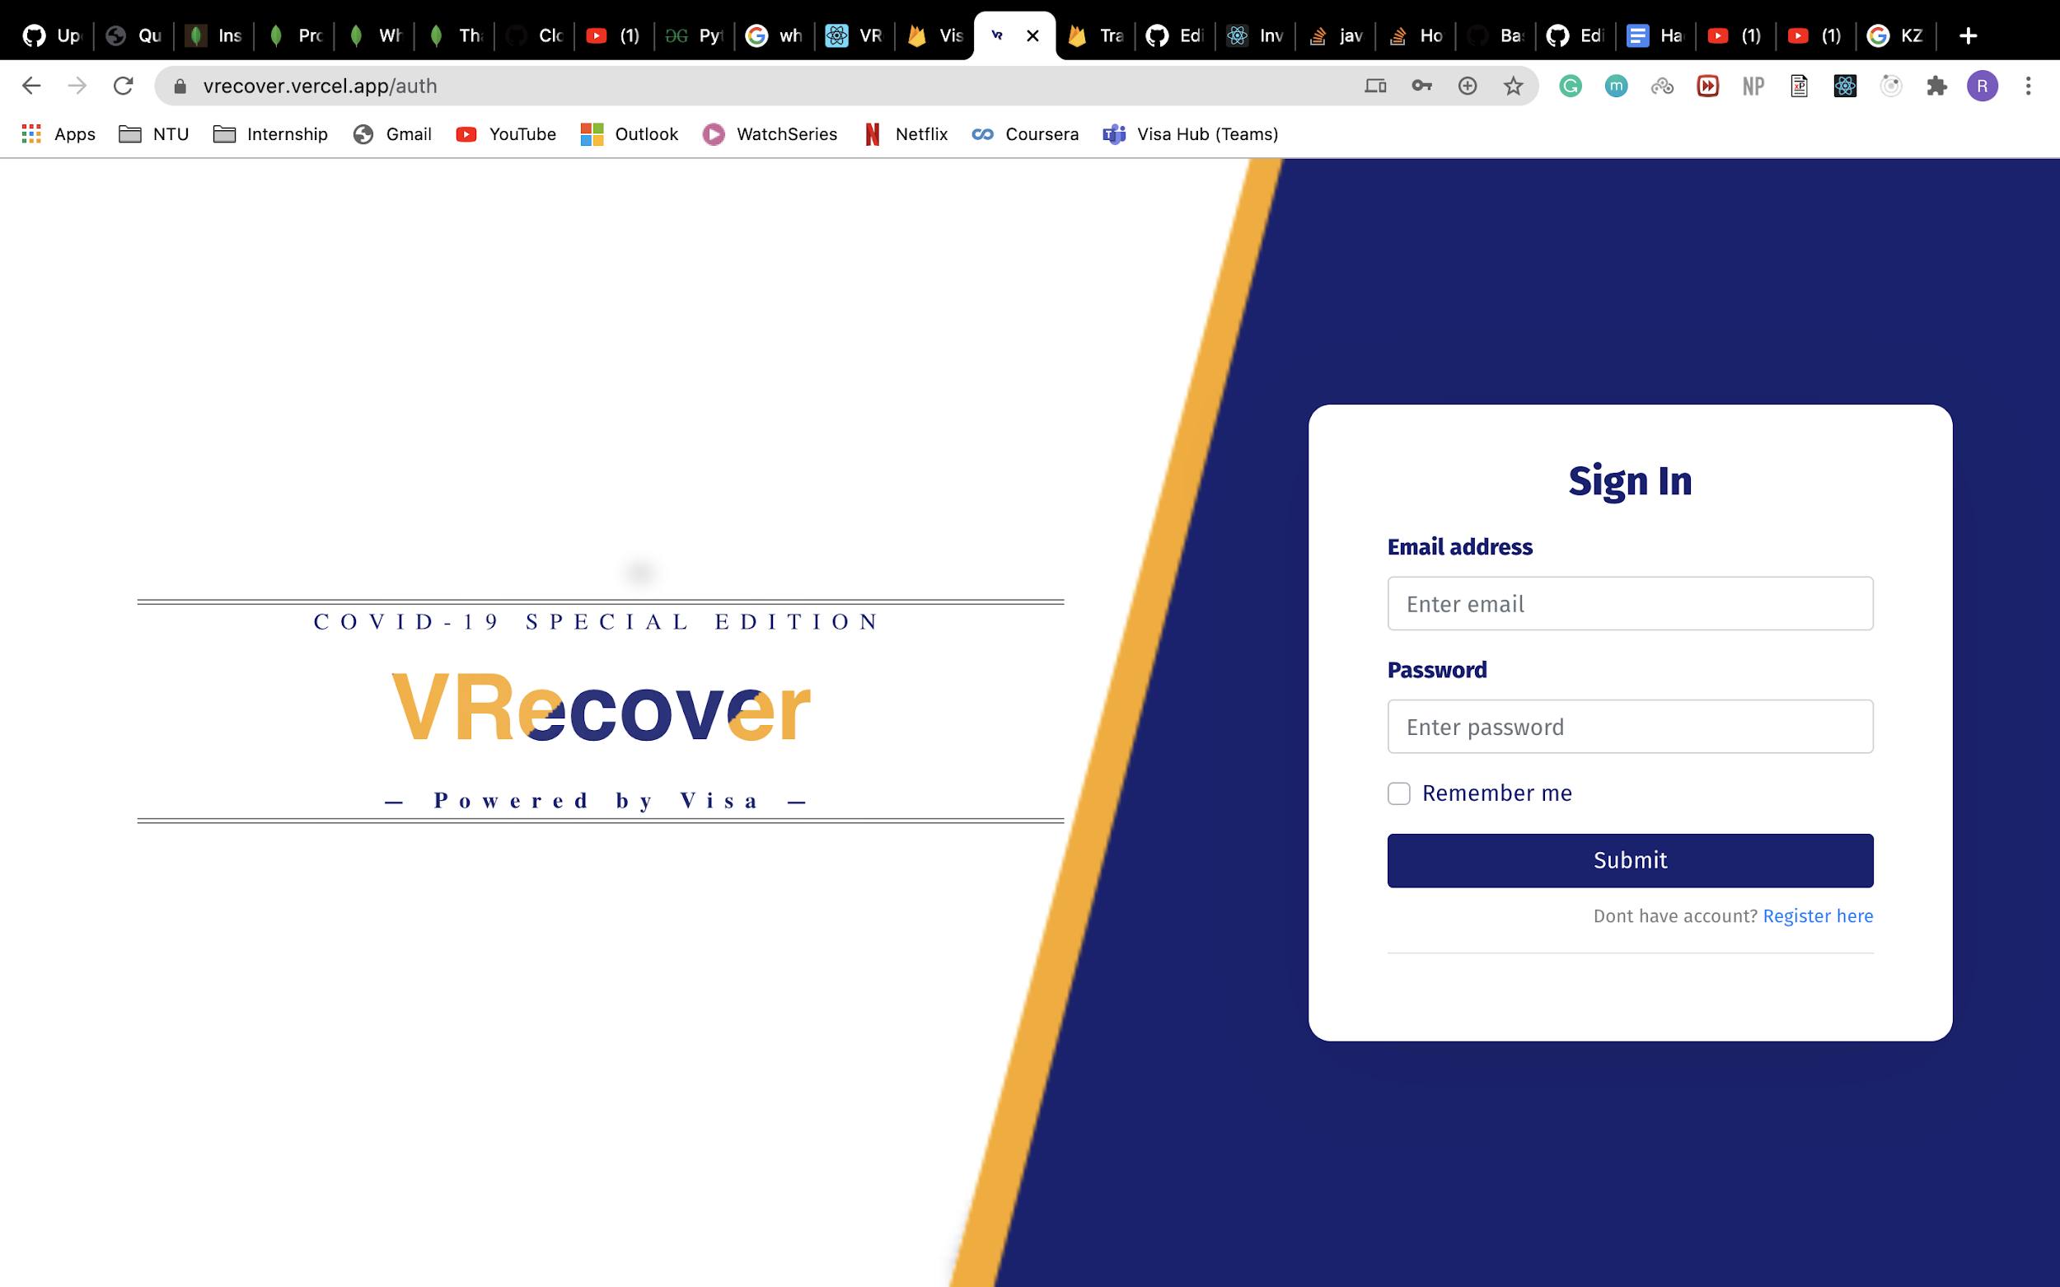
Challenges faced & How we overcame them
Challenges:
Time management as the team was across multiple time zones.
Difficulty in adapting to virtual collaboration.
How we overcame them:
Daily standup meetings and coordination using GitHub and Jira platforms
Notes:
As for our challenges, we had time management issues as our idea requires intense research and we had different time zones.
Sometimes, there was miscommunication too.
To overcome them, we have daily standup meetings and used Jira and GitHub.

Slide 10
Learnings from this hackathon
Ideation: Criteria for loans, Cash Flow, Net Margin, Return of investment (ROI), Sales Volume Growth
Technology: Node.js, ReactJS, Firebase, Vercel
VISA’s APIs: Merchant Measurement API, Merchant Locator API
Agile project management tool: Jira
Notes:
we learnt about the criteria for loans, cash flow and return of investment.
we also learnt about node.js, react, firebase and vercel,
For APIs, we learnt about merchant measurement and merchant locator api.
We also learnt how to use jira.

Slide 11
Team Members’ Roles
Navalika Sharda (Birla Institute of Technology, Mesra, India)
Scrum Master & Developer
Priti Shaw (Jadavpur University, India)
Developer
Rahul Jaiswal (National Institute of Technology, Warangal, India)
Developer
Yash Goyal (Indian Institute of Technology, BHU, Varanasi, India)
Developer
Ritwik Kanodia (Nanyang Technological University, Singapore)
Developer
Jovan Huang (Nanyang Technological University, Singapore)
Quality Assurance
.
Notes:
In our team, we have Navalika as our scrum master and developer.
Our developers are also Priti, Rahul, Yash and Ritwik and I, played the role of quality assurance.

Slide 12
Thank you!
Any questions?
vrecover.vercel.app
Notes:
Thank you for your time, Feel free to ask any questions.

